Slide 1
Dashboard in a Day
Training on the Cornerstone Dashboard Framework

Slide 2


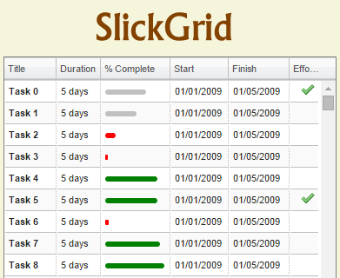



“Curve” – High-Level Solution Architecture
Client Layer: HTML5, CSS, Javascript
Dashboard Components
Sales Drivers
Bump
Band-width
Price Gap
Promo ROI
Elas
Tools
Beat- the- Curve
Elas-Profit Map
Cat Opt
SSL Encryption
Server Layer: Ruby on Rails
Microservices: Python
REST API
REST API
REST API
REST API
REST API
Weekly Sales Data
Elasticity
Feature Calendar
Financials
Scenario Plans
Cross Effects Solver
Elasticity Solver
Portfolio Advisor Solver
Nielsen
SSL Encryption
Infrastructure Layer: Amazon
Curve Loader
IRI
Web Servers
Worker Servers
Curve Loader
Database
Curve Loader
Retail POS
Web Servers
Worker Servers
Web Servers
Worker Servers
Linux
Linux
Postgres
Windows Server

Slide 3
Benefits of Cornerstone Dashboard Framework
Maximize Code Reuse
(easier to support, maintain and enhance)
Leverage Pre-Built Dashboard Components
(don’t re-invent the wheel use the Cornerstone way)
Common Approach Across All Dashboards
(once trained you can support all existing dashboards)
Rapid Time to Build New Dashboards
(from months to weeks)
Common Look & Feel Across Dashboards
(input parameters are always in the same place)
Faster to Evolve
(change framework and all dashboards will benefit)

Slide 4
Dashboard Creation Steps
Define User Story
Create the Scaffold
Add Layouts
Add Components
Get the Right Data
Update Components with Data
Finishing Touches
Update Dashboard Parameters
Add Interactions Across Components
Create your dashboard the “Cornerstone Way”

Slide 5
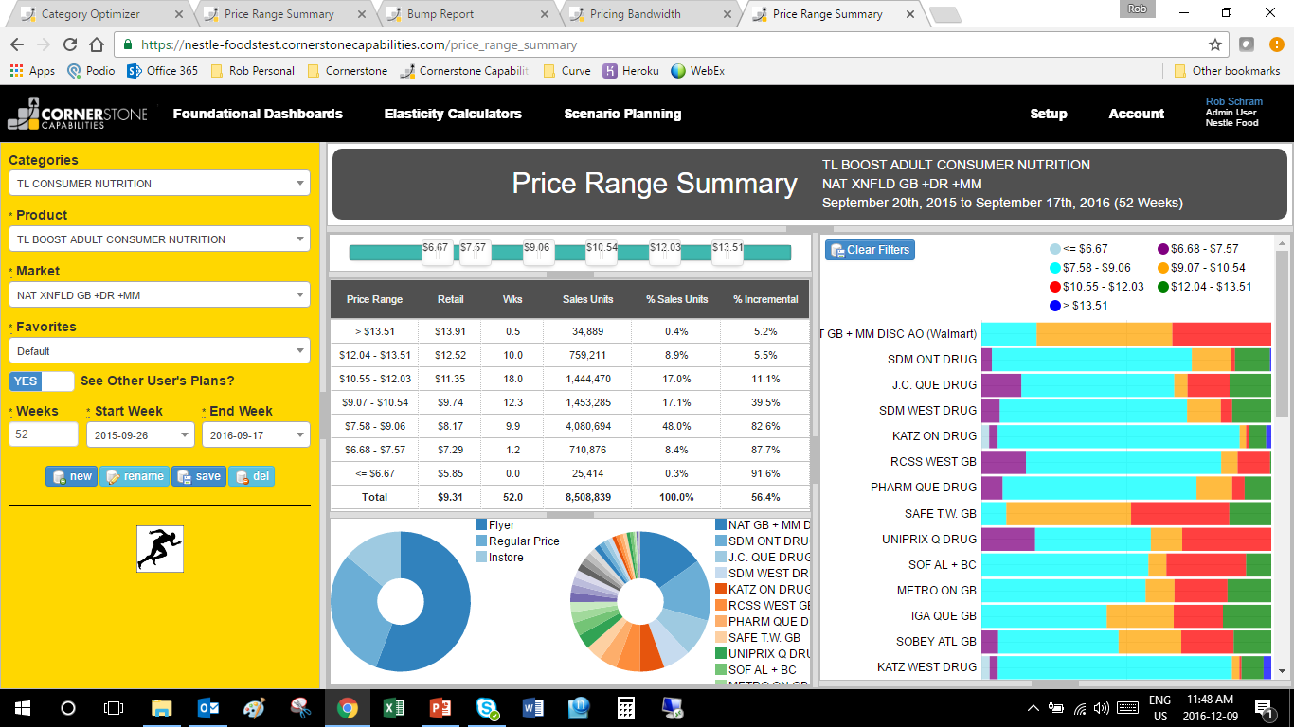
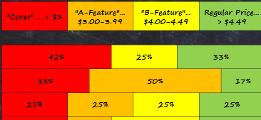
Define User Story
Define User Story
Name dashboard “Rangefinder”
Also – rename Promotion ROI Report to “Promo ROI”
Price Range Summary
Slider – Show where avg, retail and promo prices are on line – hover over to get actual value (use same colour/symbols as we use in bandwidth).
Lowest Price
Highest Price
Right click the slider handle to delete a price range. (would love to right click on the bar to add a range – but limit the maximum number of ranges to the 7 we have).
$1.99
$5.99
Units % of Sales % incr #wks
Remove the small line in the slider handle and center the label.
Price
Banner #1
Banner #2
Banner #3
Banner #4
$5.62
$3.67
$3.10
$2.12
10,567
12,904
8,093
120,098
9%
10%
7%
74%
.3
.5
3.2
5.2
$4.89
16wks
Add the fact % on Display to the selectable facts
$3.49
$2.99
12wks
24wks
Filter
Units % of Sales % incr #wks
Colours – in general needs work (difficult to tell what has been selected.)
3 shades of blue in promo condition pie not working
Should highlight with yellow background in legend for any selections across all charts
Price range summary bar should be green
Eliminate
Price
$5.99 - $4.90
$4.89 - $3.50
$3.49 - $3.00
$2.99 - $1.99
$5.62
$3.67
$3.10
$2.12
10,567
12,904
8,093
120,098
9%
10%
7%
74%
5%
10%
50%
85%
.3
.5
3.2
5.2
When banners are showing the number of weeks for Flyers, they should be integers (not base weighted).
Click Total in Price Range Table to clear the price ranges
Total:
$2.30
150,000
100%
55%
9.2
Ordering in Promo condition pie – should be “Regular Price”, then “Instore”, then “Flyer”
(also have them horizontally above the pie, and use 3 very different colours)
Would like the data table – at least via Excel export. Data table to include the same facts that are in the summary table in middle panel
Price Movement for Simulation in Optimizer
Technicolour Banner Wheel – don’t like it. Lets limit to 10 banners and show an “all other” for the remainder. Eventually would like to show smarter groupings on banners but will need more hierarchies in our models and a consistent approach across customers. If possible have a button to add more banners
Regular Price
It’s always grabbing 52wks regardless of timeframe selected
Simulation box – should be closed by default with a button to open.
Within box, only show Price Chg number & Price %Chg (don’t show starting & ending retails). Also, add an input box to allow users to enter the lowest prices they want to get rid of.
Instore
Change 1 of these to a regular pie chart, (goal is to not have this look like owl eyes). If it looks odd with two different types of pie charts, then make both regular pie charts.
Flyer
Total
Never start development without a wireframe!
Get to a prototype as quickly as possible
There will be lots of feedback
Don’t take offense!

Slide 6
Create the Scaffold: Dashboard Types
Create The Scaffold
Most dashboards are standard configs
Pre-defined input parameters include category, ppgs, banners, clusters, start date, end date duration etc.
Parameters can be turned on/off depending on dashboard.
Only used for Category Optimizer today
Extends input parameters to Base and Scenario Plans
Also saves ’aggregated facts’ over a time period as part of the plan
No pre-defined parameters in config
Used for “Setup” Dashboards
E.g. Setup Financials, Load Data, Import Data
Base Config
Simple Config
Standard Config

Slide 7
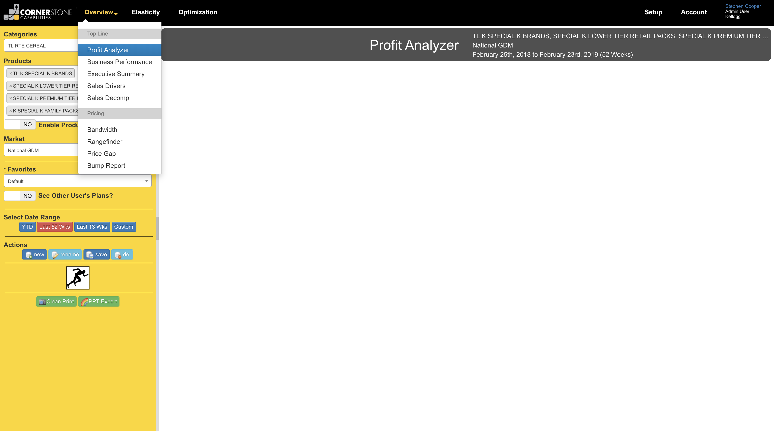
Create a Dashboard with a Single Command
Create The Scaffold
rails generate add_dashboard ProfitAnalyzer --type StandardConfig --add_switch true
Automatically Generates
Javascript
CSS
Controller
Helper
Run Job
HTML Views
Routes
Ability to Turn On/Off Dashboard if ‘add_switch’ is true
Migrations
All Cornerstone Framework Features Automatically Available
Dashboard in menubar
Input all parameters in gold
Run button works – real data
New, save, save as, rename and delete all work
Chart title bar works
Create power-point works
rails generate remove_dashboard [dashboard_name]
Delete all Dashboard Code in 1 Command

Slide 8
Things To Remember
Create The Scaffold
Create Dashboard in a new Git Branch
Remember to Restart Server after adding dashboard
To handle pre-compiled assets
Branch name should be same as dashboard name in CamelCase
Remember to Migrate the Database
If adding a switch to turn on/off the dashboard for the enterprise
Update Dashboard location in Navigation Bar
Do this in application_helper.rb

Slide 9
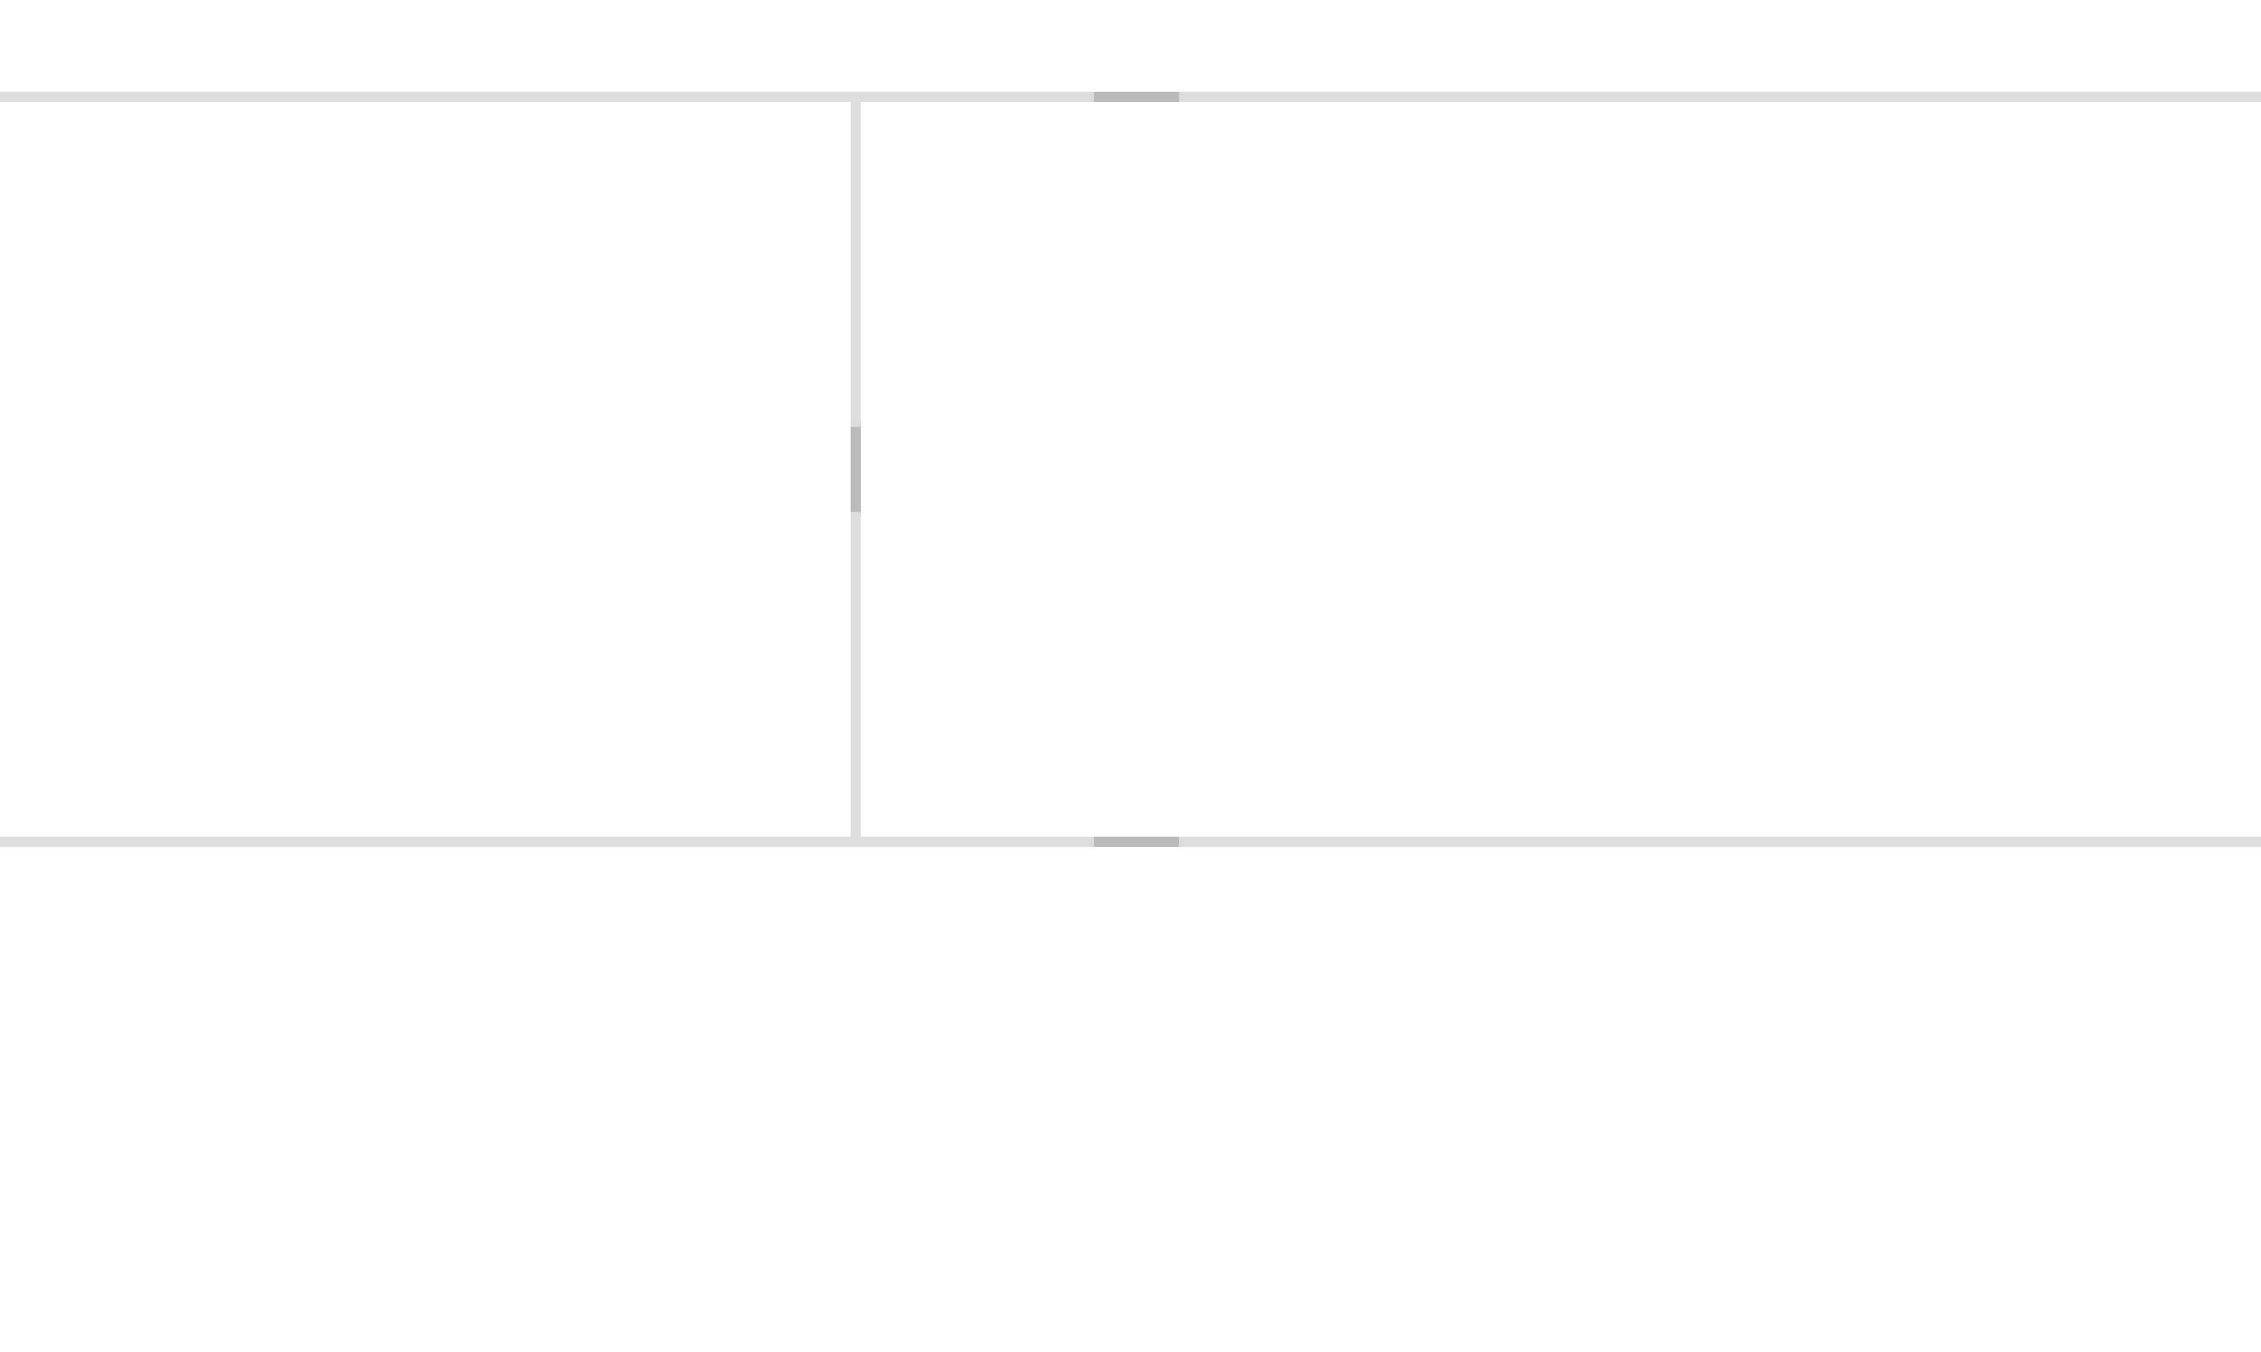
Add Layout (Creates Panes)
Add Layout
rails generate layout ProfitAnalyzer --name 'dashboard_layout' --within_id 'dashboard_working_area' --center_id 'ppg_row_pane' --ids "['slider_pane', 'line_chart_pane', 'grid_pane']" --panes "['north', 'west', 'south']" --sizes "[50, 500, 300]"
slider_pane
line_chart_pane
ppg_row_pane
(variable size pane)
grid_pane

Slide 10
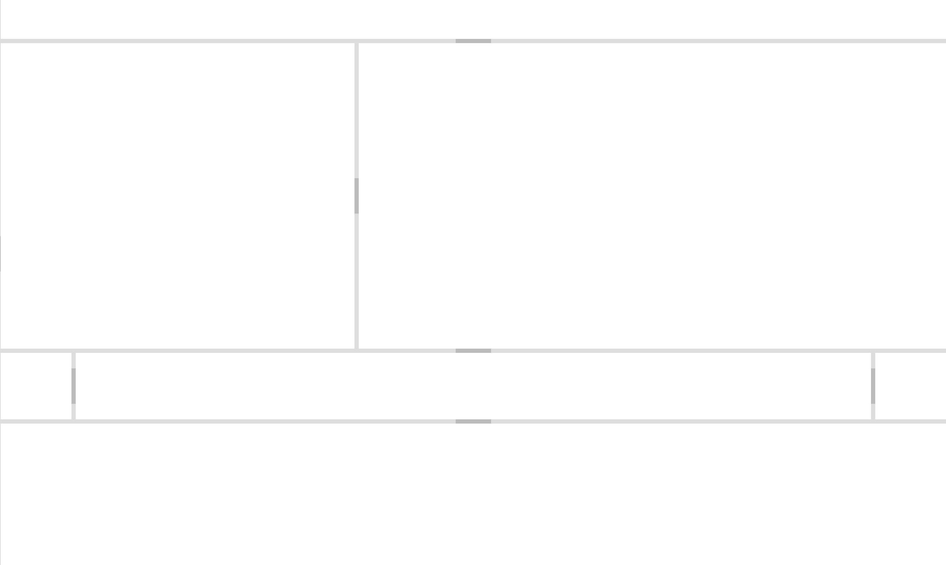
Add Layout in a Pane
Add Layout
rails generate layout ProfitAnalyzer --name 'dashboard_layout' --within_id 'dashboard_working_area' --center_id 'ppg_row_pane' --ids "['slider_pane', 'line_chart_pane', 'grid_pane']" --panes "['north', 'west', 'south']" --sizes "[50, 500, 300]"
rails generate layout ProfitAnalyzer --name 'layout_in_a_pane' --within_id 'grid_pane' --center_id 'center_pane ' --ids "['east_pane', 'west_pane', 'south_pane']" --panes "['east', 'west', 'south']" --sizes "[100, 100, 200]"
slider_pane
line_chart_pane
ppg_row_pane
west_pane
center_pane
east_pane
south_pane

Slide 11
Things To Remember
Add Layout
Center Pane is Variable Size
Layouts can be Referenced by Name
e.g. this.layouts.dashboard_layout can be accessed from anywhere in the dashboard
Put content in this pane that can grow or shrink with large or small screens
You can Control the Layout Functionality
this.layouts.dashboard_layout.disableClosable('north');
this.layouts.dashboard_layout.disableResizable('north');
this.layouts.dashboard_layout.disableSlidable('north');
this.layouts.dashboard_layout.options.north.spacing_open = -1;
this.layouts.dashboard_layout.hide('north');
this.layouts.dashboard_layout.show('north');
Top Level id is 'dashboard_working_area'

Slide 12
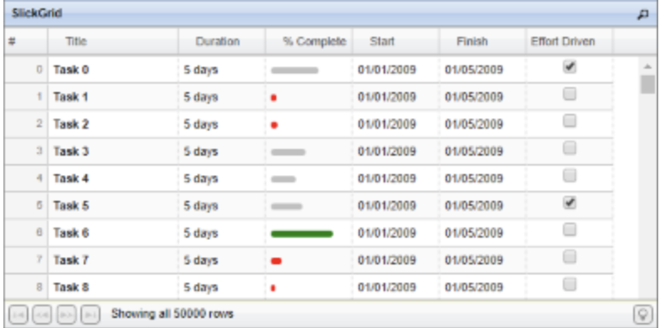

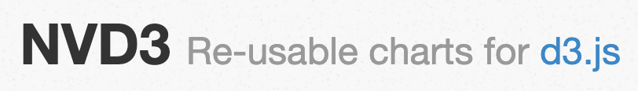
Components
Add Components
Components are ‘pre-built’ objects that talk to 3rd party open source libraries the “Cornerstone Way”
They can be extended and customized for any dashboard – scaffolds show you how!
dc_line_chart
dc_bar_chart
dc_pie_chart
dc_row_chart
nvd3_multi_bar_horizontal_chart
Scaffolds
slickgrid
slider
Pre-Built Component
ComponentSlickgrid
ComponentDc
ComponentNvd3
ComponentSlider
Open Source Library

Slide 13
Component Methods
Add Components
constructor
create_dom
setup_blob
initialize and set global attributes of the component
embed the component in the DOM
define the attributes of the component that should be saved in the favorite (e.g. scroll location in grid, columns picked, sort direction, filters, row, selections etc.)
set_defaults
trigger appropriate events to update the component based on the saved defaults on initial load
resize
make the component responsive... set size and margins whenever the layout pane is resized.
wire_events
handle any 'on_click' or other events that may occur on the component
update
convert data structure from the 'reference_data' json (from server) to the component and update the component.
create
build the component
Each of these methods come ‘pre-built’ in the component library but can be extended in the generated scaffold.

Slide 14
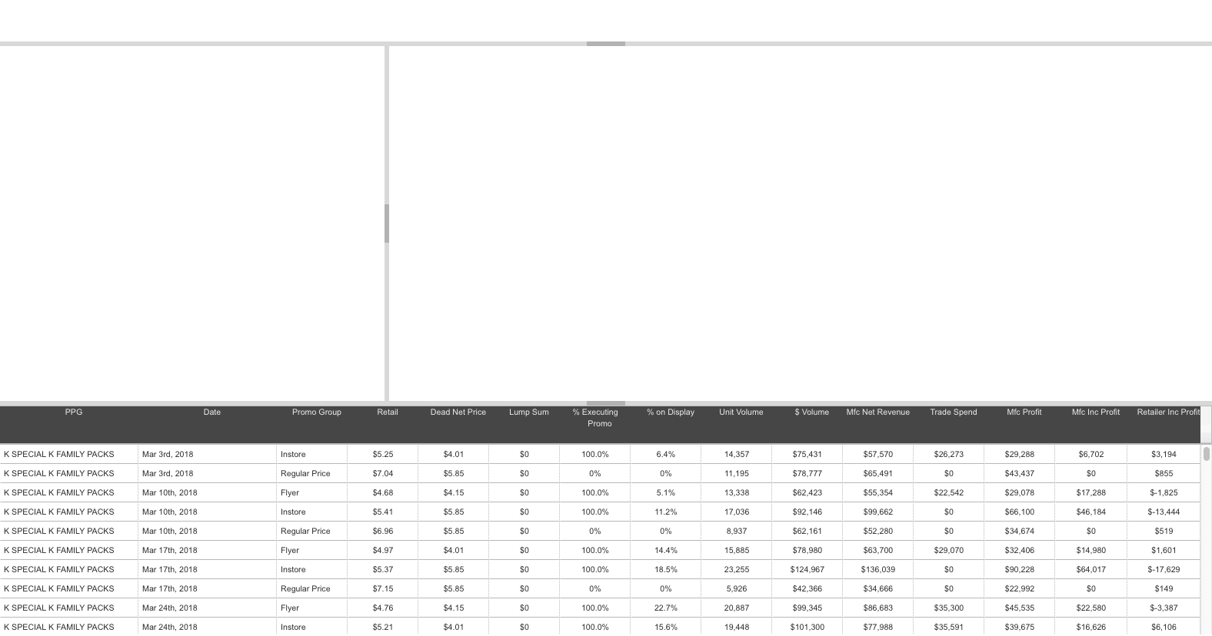
Slickgrid Component
Add Components
rails generate slickgrid ProfitAnalyzer --name 'details_grid' --pane_id 'grid_pane'
Dashboard Framework will add a Slickgrid into the selected pane and configure it with pre-defined settings.
You can now configure this with the specific data and behavior needed for the dashboard

Slide 15
Slickgrid Component – Things To Remember
Add Components
Setup columns and options for the grid in the constructor
Change the update function
Most development for a grid occurs in the update function. This is responsible for converting from the source data (typically in a crossfilter) to the specific columns and rows for the grid.
Over-ride the pre-defined defaults. Define options for column-picker, cell/row selection, tooltips, saving grid coordinates, drag rows, re-ordering/re-sizing columns, filtering, sorting and colour coding.
Augment grid behaviour
In the create function, you can add functionality for user clicks, right click menus, or changes a value in a cell
Add buttons or drop-downs on grid as requred
You will need to update the create_dom function (and css) to define the buttons and implement the 'on click' behviour in the wire-events function. You may need to call the this.dashboard.create_blob function if you want the dashboard to save the state.
Remember to Restart Server after adding the component
To handle pre-compiled assets

Slide 16
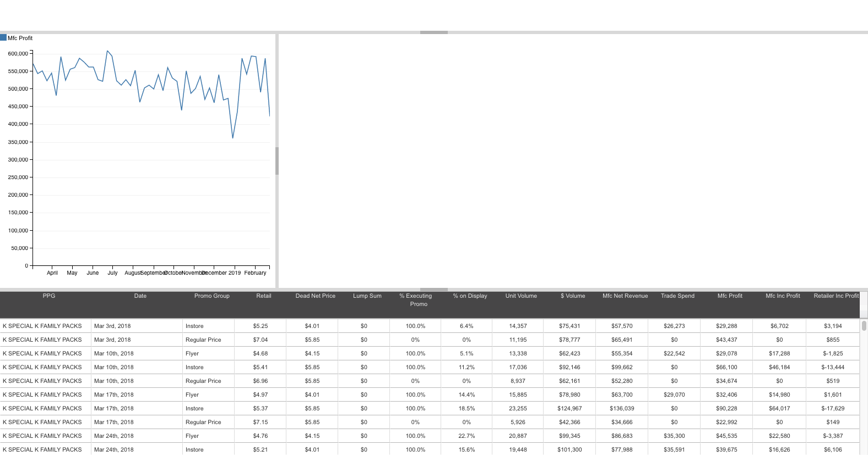
Dc.js Component
Add Components
rails generate dc_line_chart ProfitAnalyzer --name 'profit_line_chart' --pane_id 'line_chart_pane'
Dashboard Framework will add a DC.js line chart into the selected pane and configure it with pre-defined settings.
You can now configure this with the specific data and behavior needed for the dashboard

Slide 17
Things To Remember
Add Components
Pass chart pane_id and group_id to the super constructor
DC library is well documented online
Lots of capability to handle post-render effects
With DC.js, charts with the same group_id will automatically filter each other when clicked on update.
Update function is trivial thank to crossfilter
DC comes ‘pre-integrated’ with crossfilter so just pass in the dimension and group and valueAccessor and DC does the heavy lifting
Remember to Restart Server after adding the component
If you don’t want the charts to be linked, use a different group_id
To handle pre-compiled assets

Slide 18
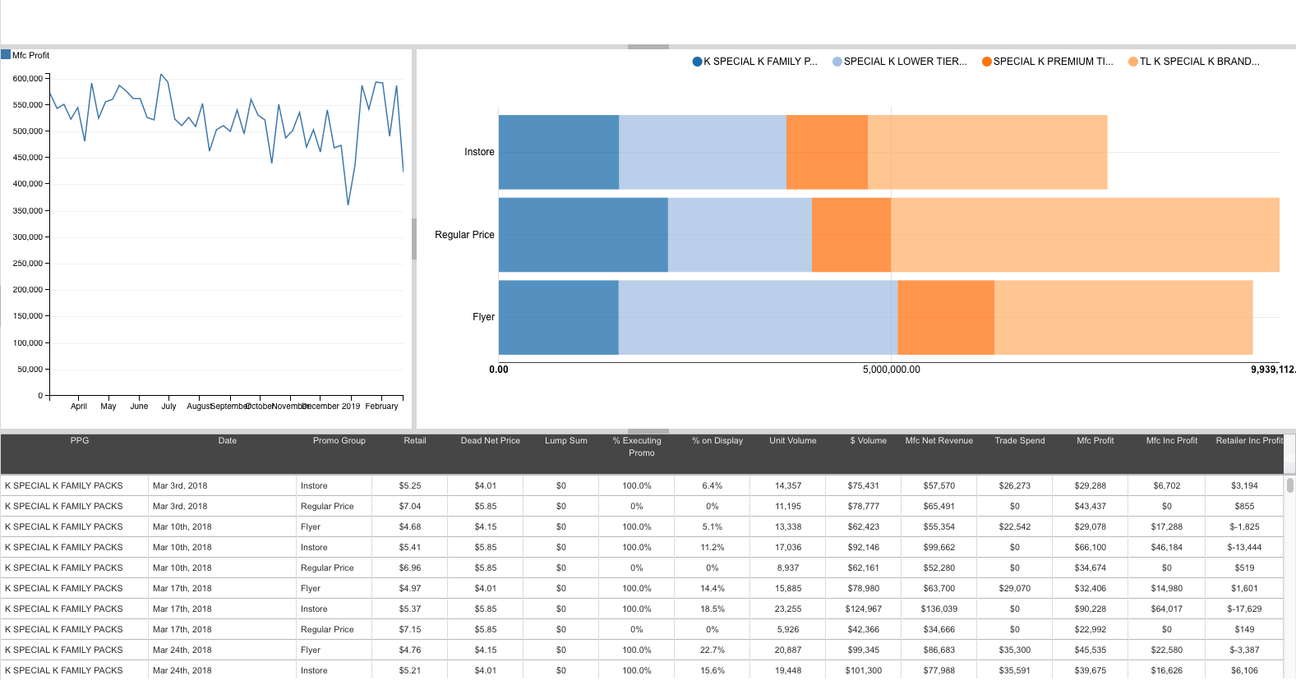
Nvd3 Component
Add Components
rails generate nvd3_multi_bar_horizontal_chart ProfitAnalyzer --name 'ppg_row_chart' --pane_id 'ppg_row_pane'
Dashboard Framework will add a Nvd3 multi bar horizontal chart into the selected pane and configure it with pre-defined settings.
You can now configure this with the specific data and behavior needed for the dashboard

Slide 19
Things To Remember
Add Components
Nvd3 is not as convenient as Dc as it doesn’t inherently use crossfilter
on_click_function will handle all the behavior when chart is clicked
Can easily parse which part of the chart was clicked for filtering
Crossfilters however can be used to transpose the data into the format required by the chart
Remember to Restart Server after adding the component
To handle pre-compiled assets
Do this logic in the update function

Slide 20
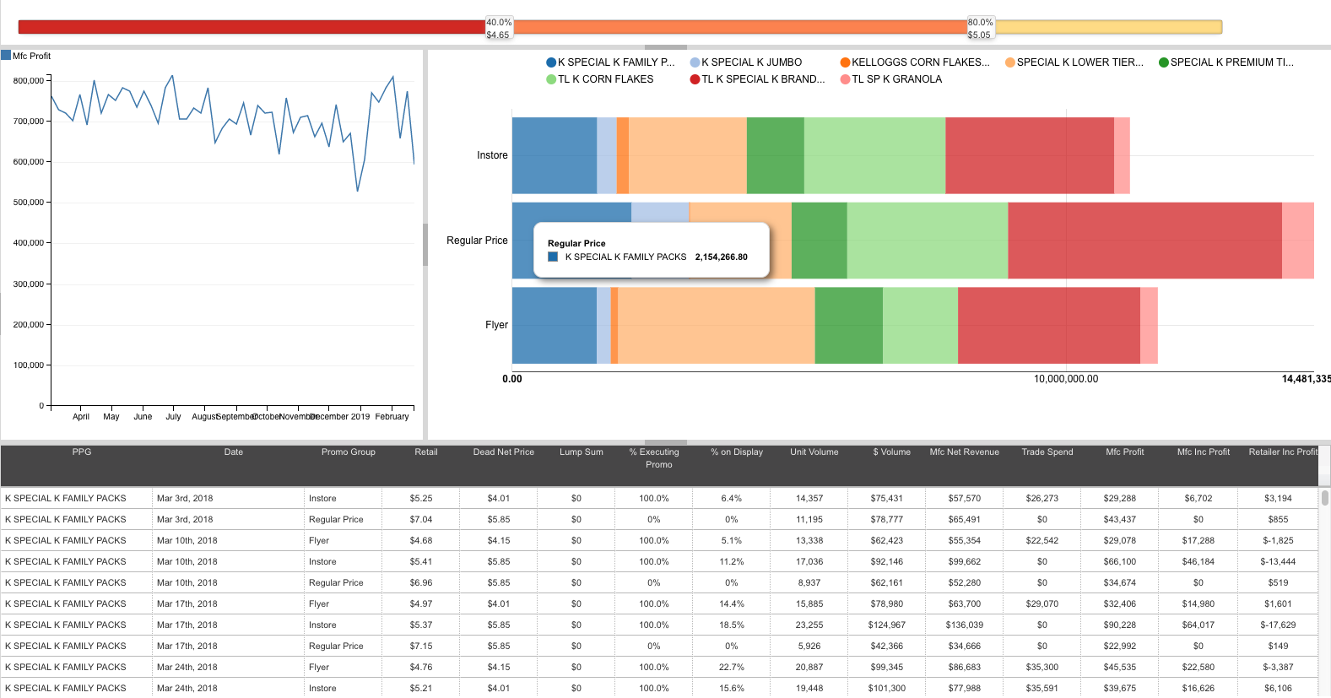
Slider Component
Add Components
rails generate slider ProfitAnalyzer --name 'slider' --pane_id 'slider_pane'
Dashboard Framework will add a slider into the selected pane and configure it with pre-defined settings.
You can now configure this with the specific data and behavior needed for the dashboard

Slide 21
Things To Remember
Add Components
Slider has all the built in capability to add handles and delete handle
Slider will save all handles and locations in the favorites
Just pass in the min and max values into the constructor
Remember to Restart Server after adding the component
To handle pre-compiled assets
Define the orientation and direction in the constructor
to_transform and from_transform setup the handle labels
on_change defines the logic to execute when handles are added, removed or moved.

Slide 22
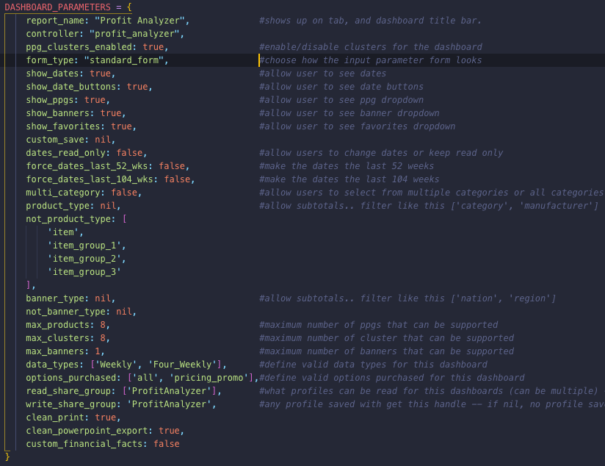
Update Dashboard Parameters
Update Dashboard Parameters
Dashboard Parameters are defined in the controller and allow you to define what input parameters (in Gold) should be turned on/off for this dashboard.
If max_products or max_banners > 1 then a multi-select will be shown to input many products or banners.

Slide 23
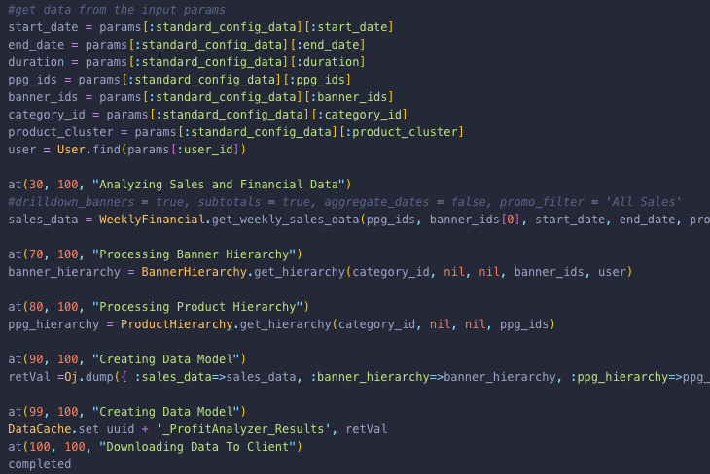
Get the Right Data – Run Job
Get The Right Data
Get the Right Data
Done in a background task (run_job)
All entered parameters are sent to the task
Leverage Ruby models to get appropriate data
You’ll need to understand our data models!
Cast reference_data in javascript dashboard object.
Weekly Sales Data
Elasticity
Feature Calendar
Financials
Scenario Plans

Slide 24
Update Components with Data
Update Components
Update function is responsible for translating between the reference_data (from the server) and the component data
Use crossfilter to help
Simplifies math and makes future proof
Done in update function on every component
Set dimensions and facts in the load_crossfilter function
Lots of examples across current dashboards

Slide 25
Add Interactions Across Components
Add Interactions
Cornerstone dashboards are highly interactive… when you click here, update here…
e.g if filtering grid based on chart click, you want to have a variable in the chart that holds the state of what has been clicked
Add variable to setup_blob and setup_defaults
This way the current state of the chart is saved and restored on reload
Define state variables in the controlling component
Add filters to the update function of the controlled component
It should get the state variable from controlling component and filter data according (e.g. using crossfilter)
Update the on_click function of controlling component to set the state variable.
Remember to call this.dashboard.create_blob() so it gets saved in the favorites.

Slide 26
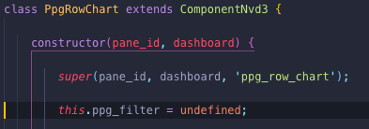
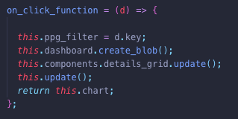
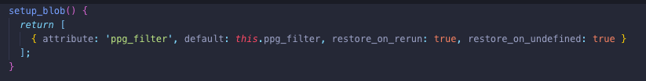
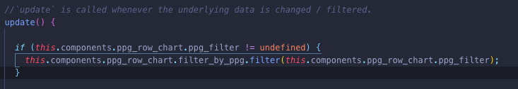

Example: Click Multi-bar chart and filter grid
Add Interactions
1. Define state variables in multi bar
3. Update on_click function on multi bar
New state variable
2. Add variable to setup_blob on multi bar
4. Add filters to update on grid
How would you also update the line plot?

Slide 27
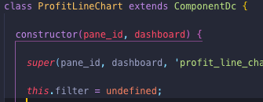
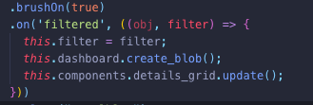

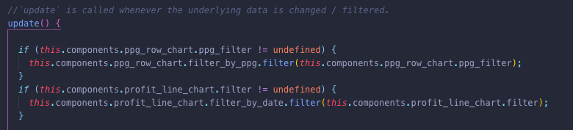
Example2: Select Range on Line and Filter Grid
Add Interactions
1. Define state variables in line plot
3. Update filter function on line chart
New state variable
2. Add variable to setup_blob on line_plot
4. Add filters to update on grid
3. Set .brushOn(true) for line plot

Slide 28
Finishing Touches
Finishing Touches
You are almost done (since each component defines their own behavior, look & feel and interaction
And the framework takes care of all the base features automatically…
However there may be some final touches…
Export to Excel
Define a button in the create dom and wire the event. When clicked, call the common_utilities.generateExcelBackground and pass it the grid.
Custom Parameters
In any dashboard in the main javascript file there is a 'custom_dashboard_parameters' callout where you can define additional inputs as requred.

